Slide 1
Chapter 1 Objectives
The CCNA Topics Covered in this chapter include:
  Why do we need a switch?
  Basic functions of a switch
  Various forwarding methods
  What is redundancy?
  What are the various problems with redundancy?

Slide 2
Layer 2 Switching
Switching breaks up large collision domains into smaller ones
Collision domain is a network segment with two or more devices sharing the same bandwidth.
A hub network is a typical example of this type of technology
Each port on a switch is actually its own collision domain, you can make a much better Ethernet LAN network just by replacing your hubs with switches
They look at the frame’s hardware addresses before deciding to either forward the frame or drop it.
  Layer 2 switching so efficient is that no modification to the data packet takes place

Slide 3
How Switches and Bridges
Learn Addresses
Bridges and switches learn in the following ways:
Reading the source MAC address of each received frame or datagram
Recording the port on which the MAC address was received.
In this way, the bridge or switch learns which addresses belong to the devices connected to each port.

Slide 4
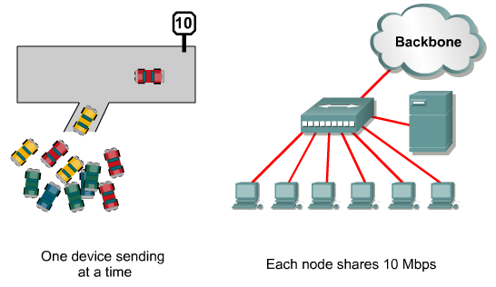
Ethernet Access with Hubs

Slide 5
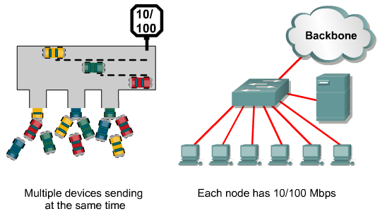
Ethernet Access with Switches

Slide 6
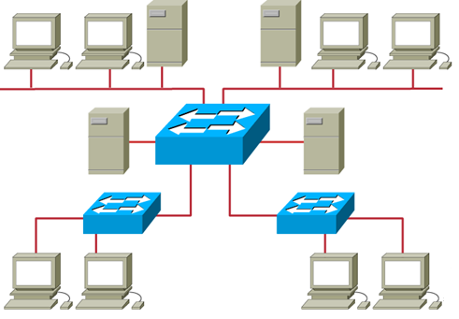
Ethernet Switches and Bridges
  Address learning
  Forward/filter decision
  Loop avoidance

Slide 7
Switch Features
There are three conditions in which a switch will flood a frame out on all ports except to the port on which the frame came in, as follows:
  Unknown unicast address
  Broadcast frame
  Multicast frame

Slide 8
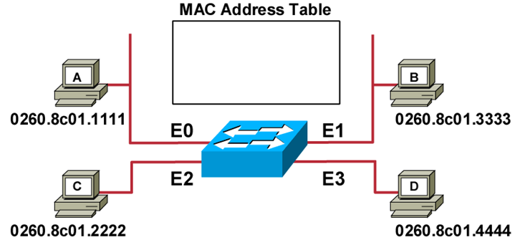
MAC Address Table
Initial MAC address table is empty.

Slide 9
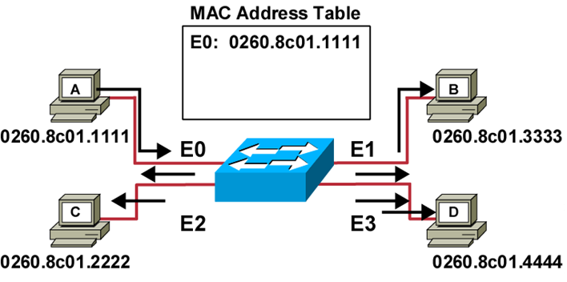
Learning Addresses
Station A sends a frame to station C.
Switch caches the MAC address of station A to port E0 by learning the source address of data frames.
The frame from station A to station C is flooded out to all ports except port E0 (unknown unicasts are flooded).

Slide 10
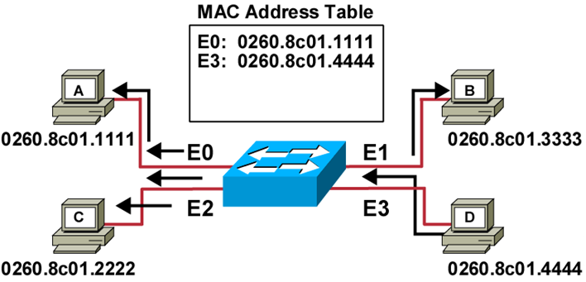
Learning Addresses (Cont.)
Station D sends a frame to station C.
Switch caches the MAC address of station D to port E3 by learning the source address of data frames.
The frame from station D to station C is flooded out to all ports except port E3 (unknown unicasts are flooded).

Slide 11
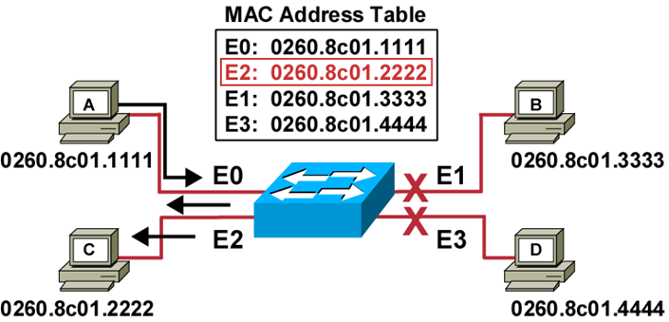
Filtering Frames
Station A sends a frame to station C.
Destination is known; frame is not flooded.

Slide 12
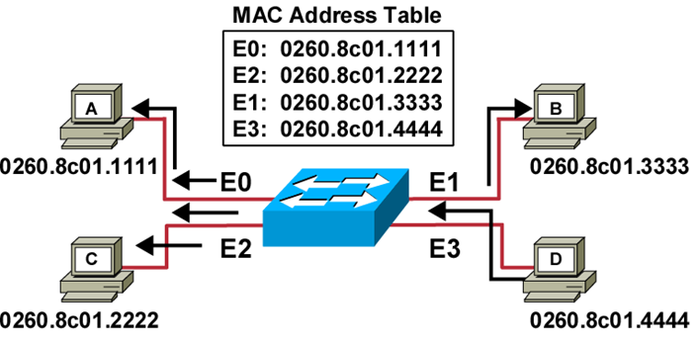
Broadcast and Multicast Frames
Station D sends a broadcast or multicast frame.
Broadcast and multicast frames are flooded to all ports other than the originating port.

Slide 13
Forward/Filter Decision
When a frame arrives at a switch interface, the destination hardware address is compared to the forward/ filter MAC database.
If the destination hardware address is known and listed in the database, the frame is sent out only the correct exit interface
If the destination hardware address is not listed in the MAC database, then the frame is flooded out all active interfaces except the interface the frame was received on.
If a host or server sends a broadcast on the LAN, the switch will flood the frame out all active ports except the source port.

Slide 14
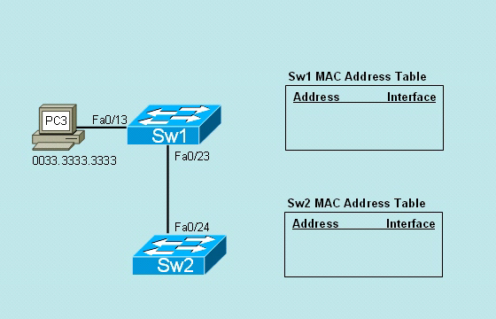
Learning Mac Address

Slide 15
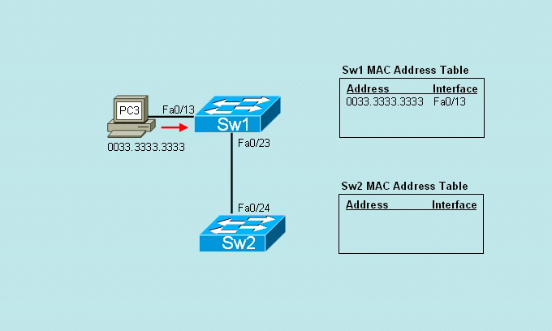
Learning Mac Address

Slide 16
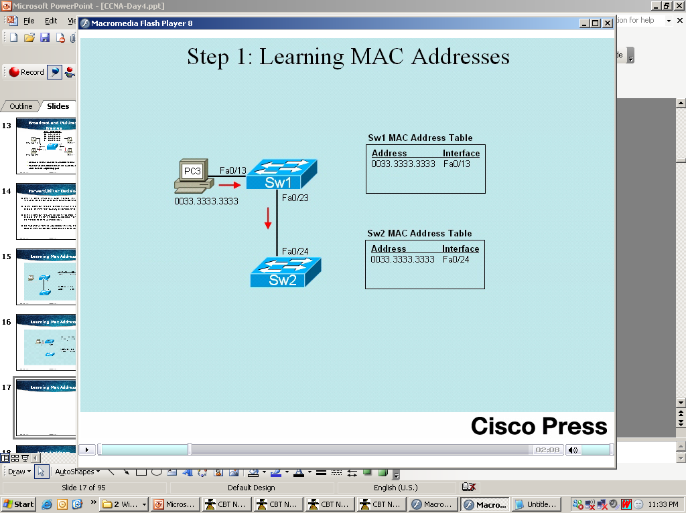
Learning Mac Address

Slide 17
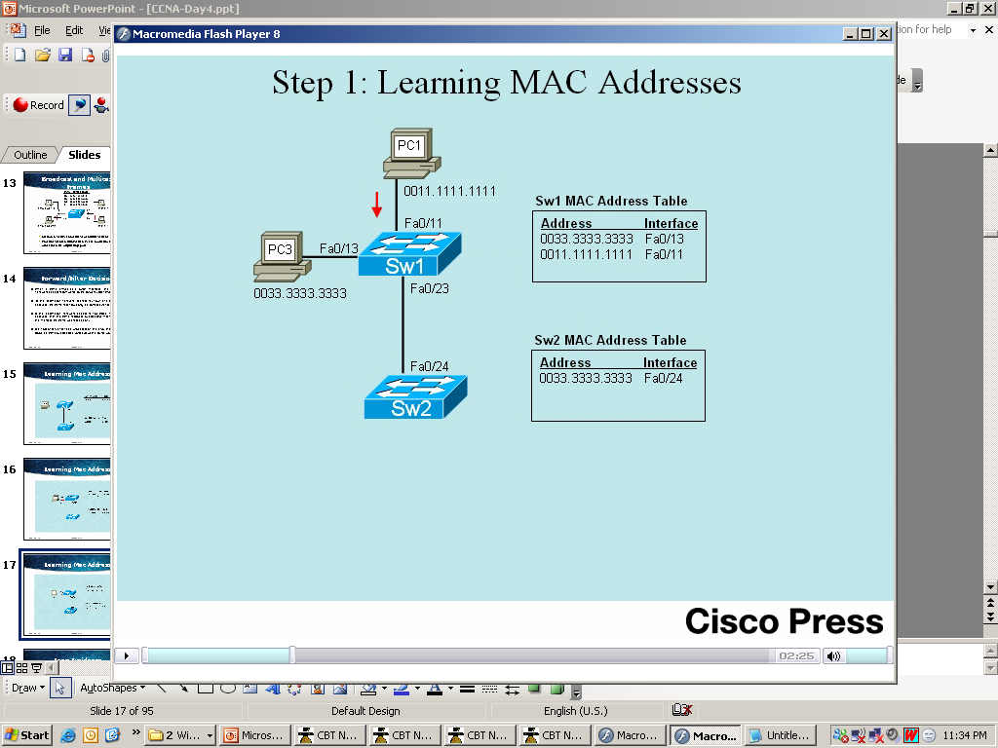
Learning Mac Address

Slide 18
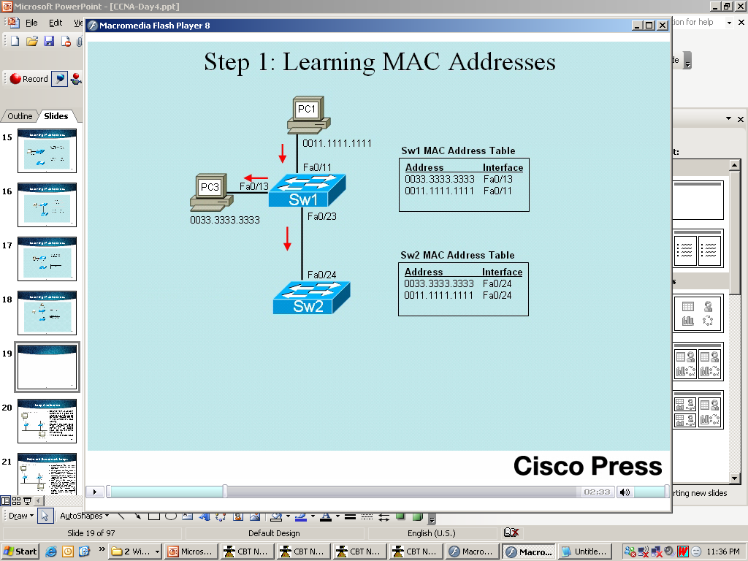
Learning Mac Address

Slide 19
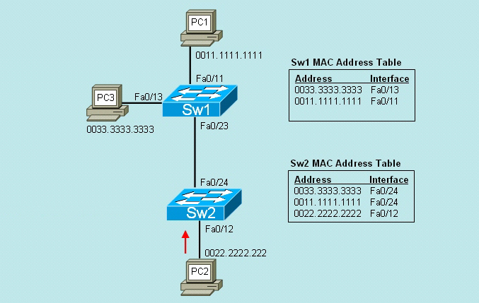
Learning Mac Address

Slide 20
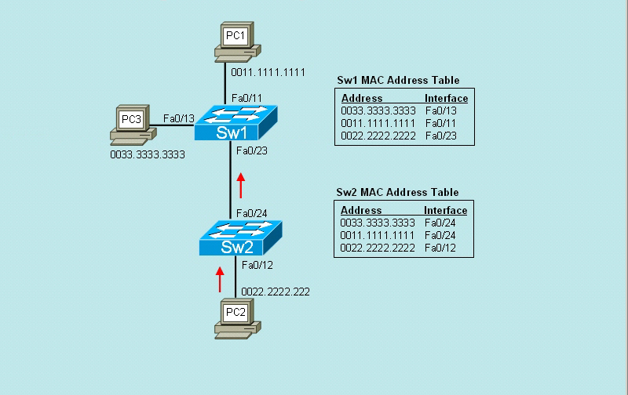
Learning MaAc Address

Slide 21
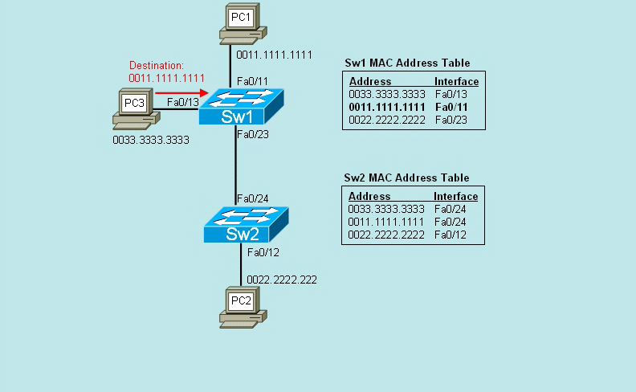
Forward/Filter PC3 to PC1

Slide 22
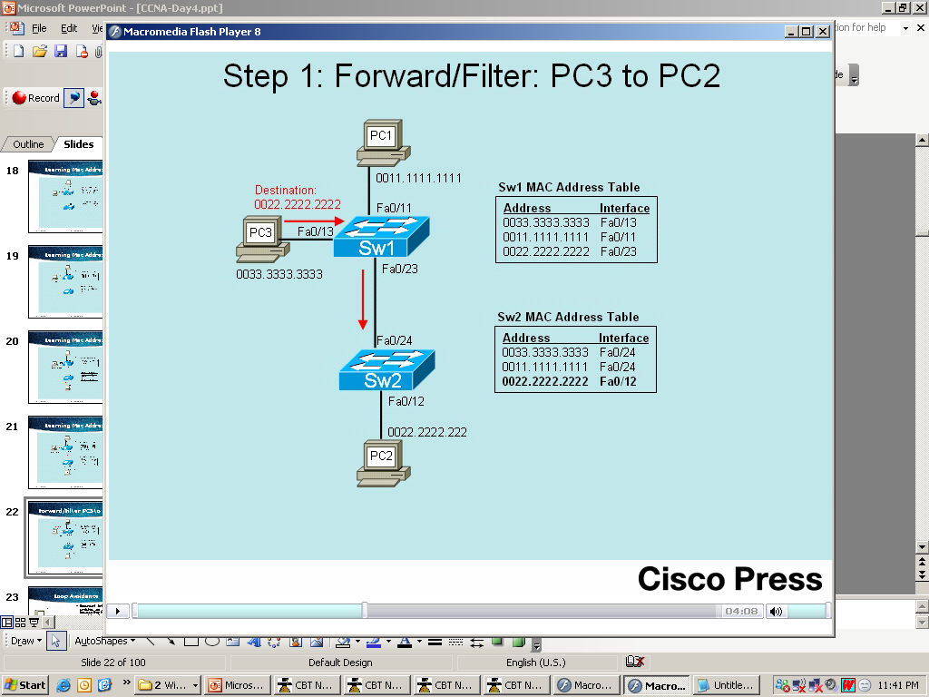
Forward/Filter PC3 to PC2

Slide 23
Switching Methods
1. Store-and-Forward
The entire frame is received before any forwarding takes place. Filters are applied before the frame is forwarded. Most reliable and also most latency especially when frames are large.
2. Cut-Through (Fast Forward)
The frame is forwarded through the switch before the entire frame is received. At a minimum the frame destination address must be read before the frame can be forwarded. This mode decreases the latency of the transmission, but also reduces error detection.
3. Fragment-Free (Modified Cut-Through)
Fragment-free switching filters out collision fragments before forwarding begins. Collision fragments are the majority of packet errors. In Fragment-Free mode, the switch checks the first 64 bytes of a frame.

Slide 24
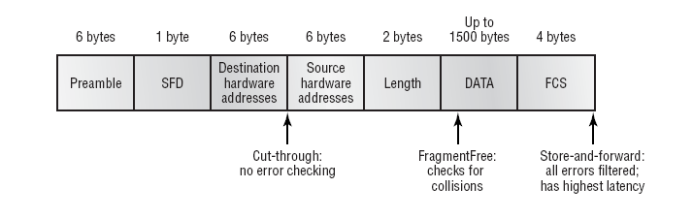
Switching Methods

Slide 25
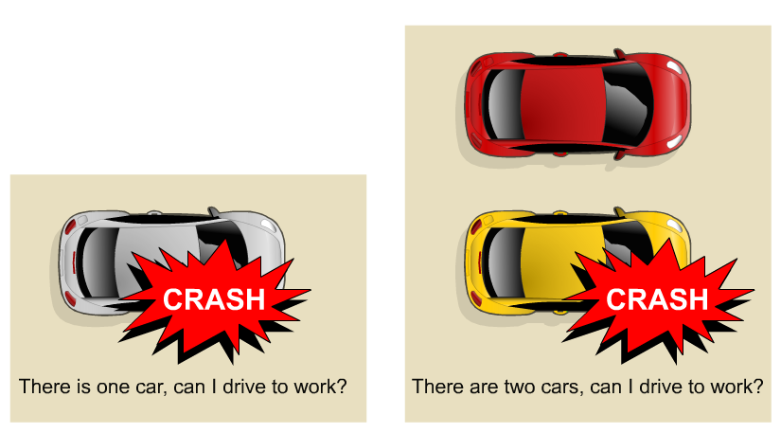
Redundancy
Achieving such a goal requires extremely reliable networks.
Reliability in networks is achieved by reliable equipment and by designing networks that are tolerant to failures and faults.
The network is designed to reconverge rapidly so that the fault is bypassed.
Fault tolerance is achieved by redundancy.
Redundancy means to be in excess or exceeding what is usual and natural.

Slide 26
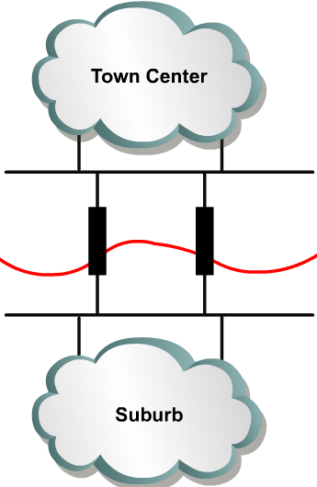
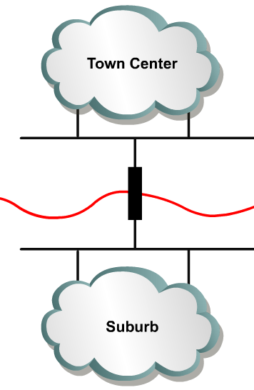
Redundant topologies
One Bridge
Redundant Bridges
A network of roads is a global example of a redundant topology.
If one road is closed for repair there is likely an alternate route to the destination

Slide 27
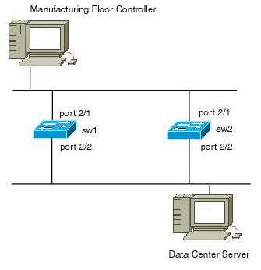
Loop Avoidance
Redundant links between switches are a good idea because they help prevent complete network failures in the event one link stops working
However, they often cause more problems because frames can be flooded down all redundant links simultaneously
This creates network loops

Slide 28
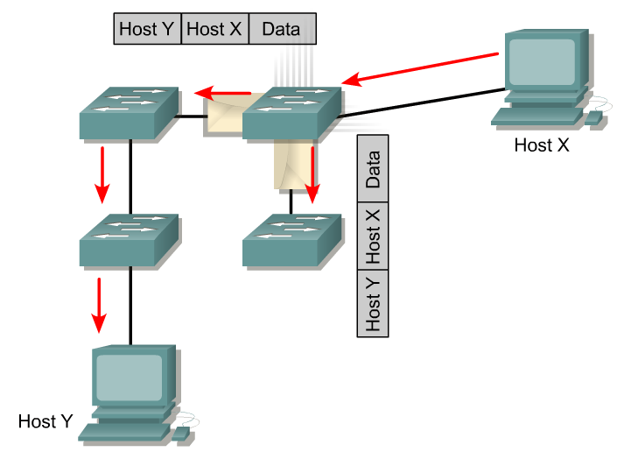
Types of Traffic
Unknown Unicast
Types of traffic (Layer 2 perspective)
Known Unicast: Destination addresses are in Switch Tables
Unknown Unicast: Destination addresses are not in Switch Tables
Multicast: Traffic sent to a group of addresses
Broadcast: Traffic forwarded out all interfaces except incoming interface.

Slide 29
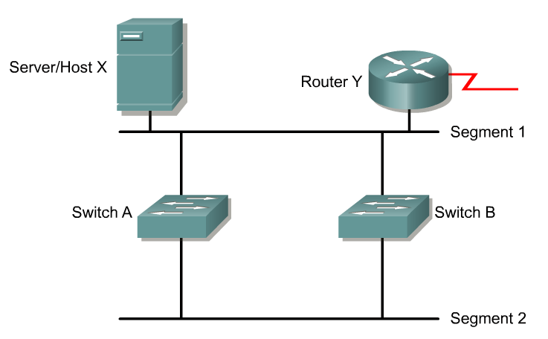
Redundant switched topologies
Switches learn the MAC addresses of devices on their ports so that data can be properly forwarded to the destination.
Remember: switches use the Source MAC address to learn where the devices are, and enters this information into their MAC address tables.
Switches will flood frames for unknown destinations until they learn the MAC addresses of the devices.
Broadcasts and multicasts are also flooded.

Slide 30
Redundant switched topology problems
The main problems with redundant switched topologies are:
Broadcast Storms
Multiple Frame Copies
MAC address table instability

Slide 31
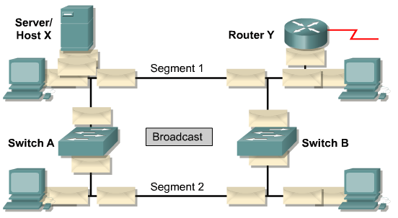
Broadcast Storm
Broadcasts and multicasts can cause problems in a switched network.
If Host X sends a broadcast, like an ARP request for the Layer 2 address of the router, then Switch A will forward the broadcast out all ports.
Switch B, being on the same segment, also forwards all broadcasts.
Switch B sees all the broadcasts that Switch A forwarded and Switch A sees all the broadcasts that Switch B forwarded.
Switch A sees the broadcasts and forwards them.
Switch B sees the broadcasts and forwards them.
The switches continue to propagate broadcast traffic over and over.
This is called a broadcast storm.

Slide 32
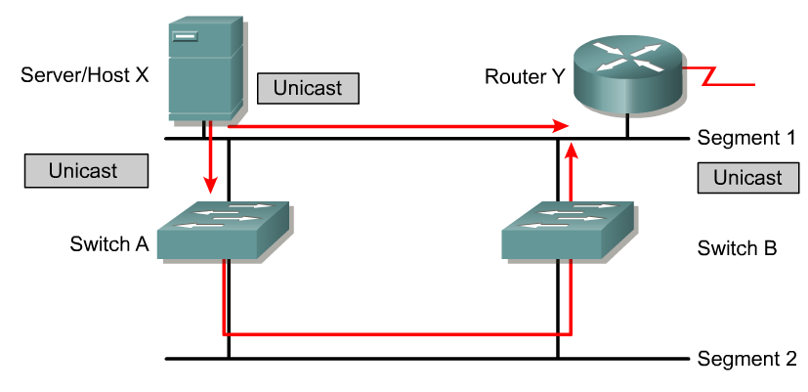
Multiple Frame Copies

Slide 33
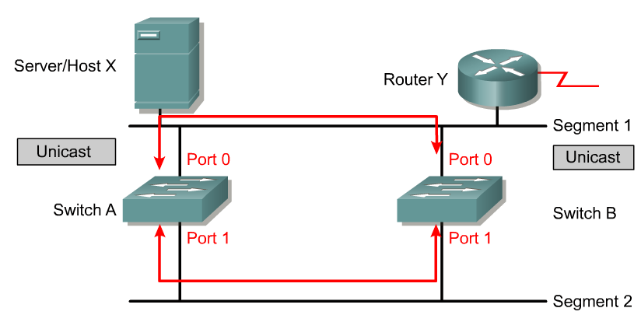
Media access control (MAC) database instability
In a redundant switched network it is possible for switches to learn the wrong information.
  A switch can incorrectly learn that a MAC address is on one port, when it is actually on a different port.
  Host X sends a frame directed to Router Y.
  Switches A and B learn the MAC address of Host X on port 0.
  The frame to Router Y is flooded on port 1 of both switches.
  Switches A and B see this information on port 1 and incorrectly learn the MAC address of Host X on port 1.

